Slide 1
IMDB MOVIE PROJECT
Findings, Hypothesis and Analysis
By: Kanishka Shashi

Slide 2
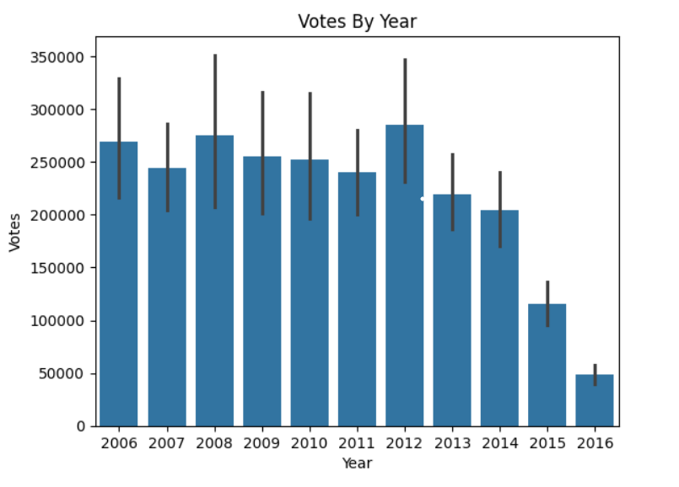

Hypothesis
Highest average voting year is 2012 and least voting year is 2016.
Described Top 10 lengthy movies of the time.
Highest Average Revenue year was 2009 and the lowest was 2016.
Analysis and Findings
Highest Average Voting Year
Highest Average Voting Year was 2012 and least was 2016

Slide 3
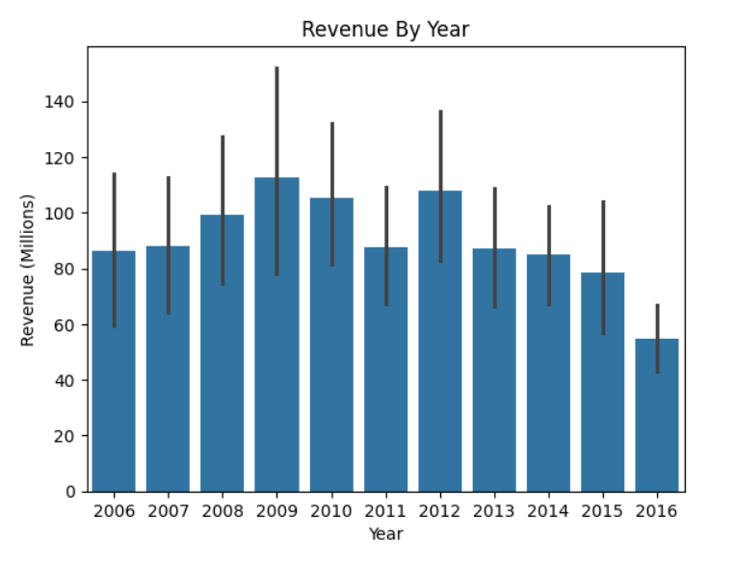
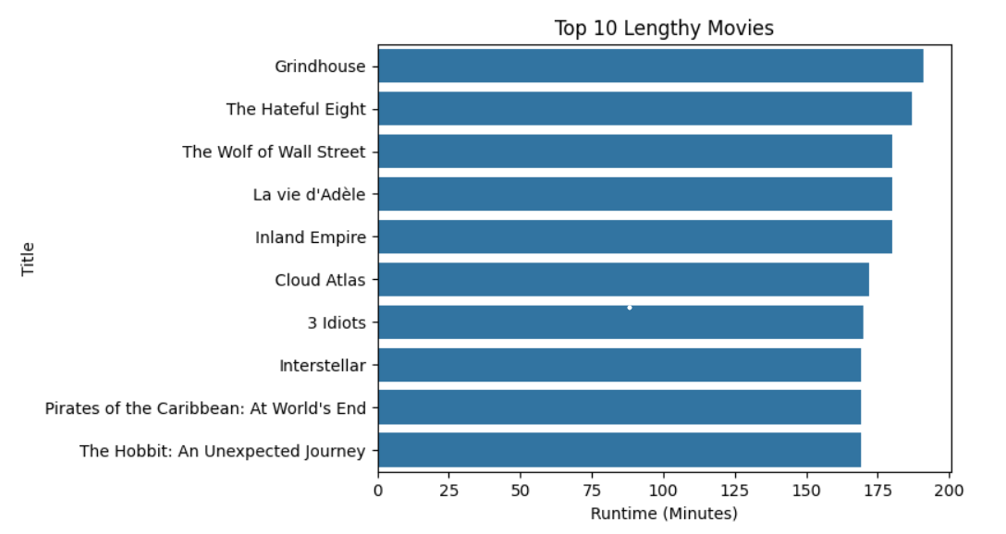

Highest Average Revenue Year
Highest Average Revenue Year was 2009 and least was 2016
Top 10 Lengthy Movies with Runtime (min)
Grindhouse was the lengthiest movie and The Hobbit: An Unexpected Journey lengthy movie

Slide 4
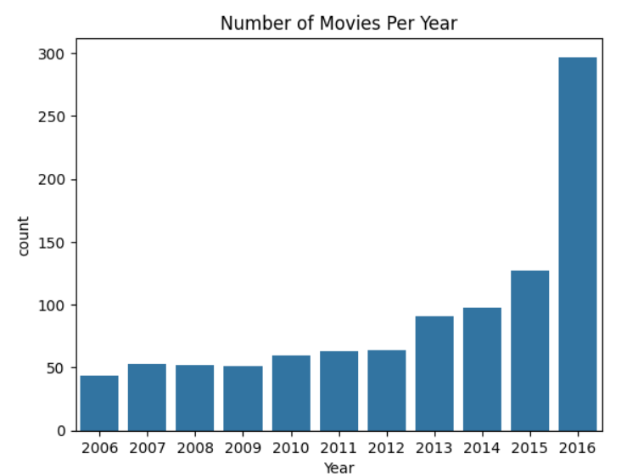
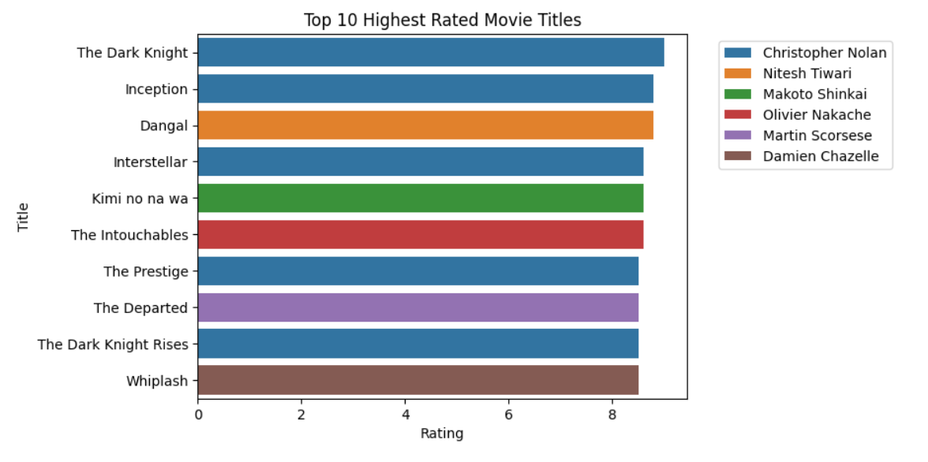
Number of movies per year
Top 10 Highest Rated Movie Titles
Highest number of movies produced was in 2016 and least in 2006
Highest Top 10 Rated Movie Title was The Dark Knight
and least was Whiplash

Slide 5
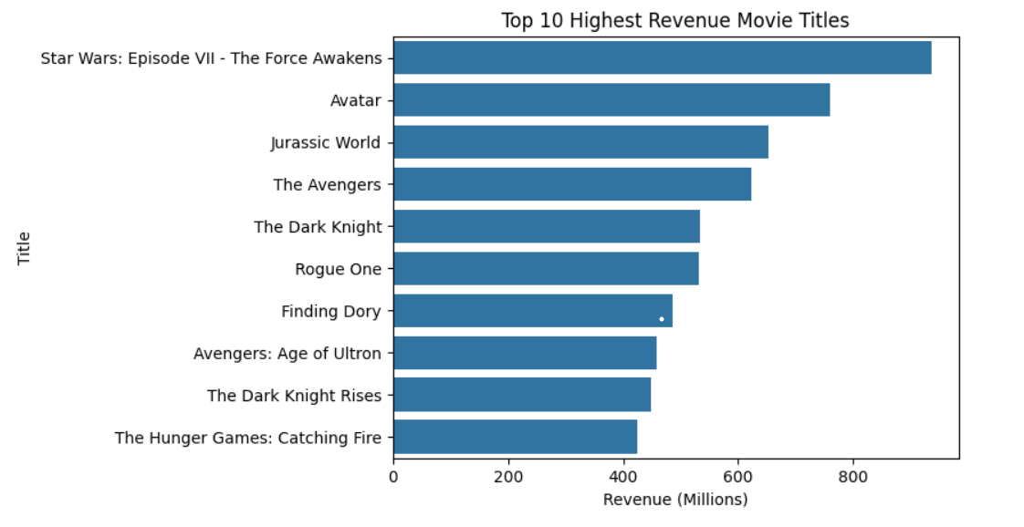
Top 10 Highest Revenue Movie Titles
Top 10 Highest Revenue Movie Titles was Star wars and the least was The Hunger Games
Thanks

